Slide 1
Oregon Community Colleges
Statewide Workshop
November 4, 2014

Slide 2
Introductions
Arleen Arnsparger
Program Manager, Initiative on Student Success
Misha Turner
Associate Director, College Relations
Mike Bohlig
Senior Research Associate
Center for Community College Student Engagement
Program in Higher Education Leadership
The University of Texas at Austin
Thank you for joining us!

Slide 3
Agenda
Student Voices
What Matters Most for Student Success – Aligning with State and National Initiatives
Overview of Oregon Colleges’ CCSSE and SENSE Data & Tracking Student Engagement Data Over Time
Digging Into Your College’s Center Data
Continue the Conversation Over Lunch
High-Impact Practices to Strengthen Student Success
Colleges Share Promising Practices
Action Planning & Next Steps
Q & A and Wrap-Up

Slide 4

Am I Ready for College?
Notes:
741

Slide 5
I have a goal!
On the CCSSE survey, Oregon Community College students say…
79% want to obtain an associate degree.
73% want to transfer to a four-year institution.
51% want to complete a certificate program.
2014 CCSSE Oregon Colleges Consortium Data

Slide 6
Oregon Students’ Goals for Attending College
All FT PT
Associate Degree: 79% 85% 75%
Transfer to 4-year: 73% 77% 70%
Certificate: 51% 51% 51%
Source: CCSSE 2014

Slide 7




Reality check: only 45% will meet their goal within 6 years
U.S. Department of Education, NCES (2001).
Beginning Postsecondary Students Longitudinal Study 1996-2001 (BPS:96/01). Analysis by Community College Research Center .

Slide 8
  Helping students succeed through the equivalent of the first semester (12–15 credit hours) can dramatically improve subsequent success rates.
  Helping students complete their first developmental course can dramatically improve subsequent success rates.
Notes:
8

Slide 9
Group Discussion
Thinking about your students’ experience at your college …
From your own perspective:
What are your college’s strengths? On what do you base that view?
What data support your perspective?

Slide 10
Students Speak
Bringing data alive through student voices

Slide 11


Slide 12
What did you hear?
About “front door” experiences?
What are some challenges students bring with them?
About learning and teaching?
Inside and outside of class?
About support for students?
Inside and outside of class?
About what makes a difference for students?
Notes:
The Center for Community College Student Engagement uses two approaches to better understand students’ college experiences: the surveys, which provide detailed quantitative data, and the Initiative on Student Success, which provides qualitative data.
The Initiative on Student Success, supported by Houston Endowment Inc. and the MetLife Foundation, conducts focus groups and interviews at select colleges, gathering the perspectives of students, faculty, student services professionals, and presidents to paint a more complete picture of the student experience.
The surveys’ rich data help colleges better understand what is happening. Data from the focus groups and interviews can help them begin to figure out why.

Slide 13
Oregon Community College
Connection and Preparation,
Progression and Completion
Strategic Plan 2013-2015
Essential Values:
Students have the right to succeed – not the freedom to fail.
Learning is the CENTER for all of us.
Honor the intent of the student’s goal – engage to expose students to the horizons of learning for a lifetime.

Slide 14
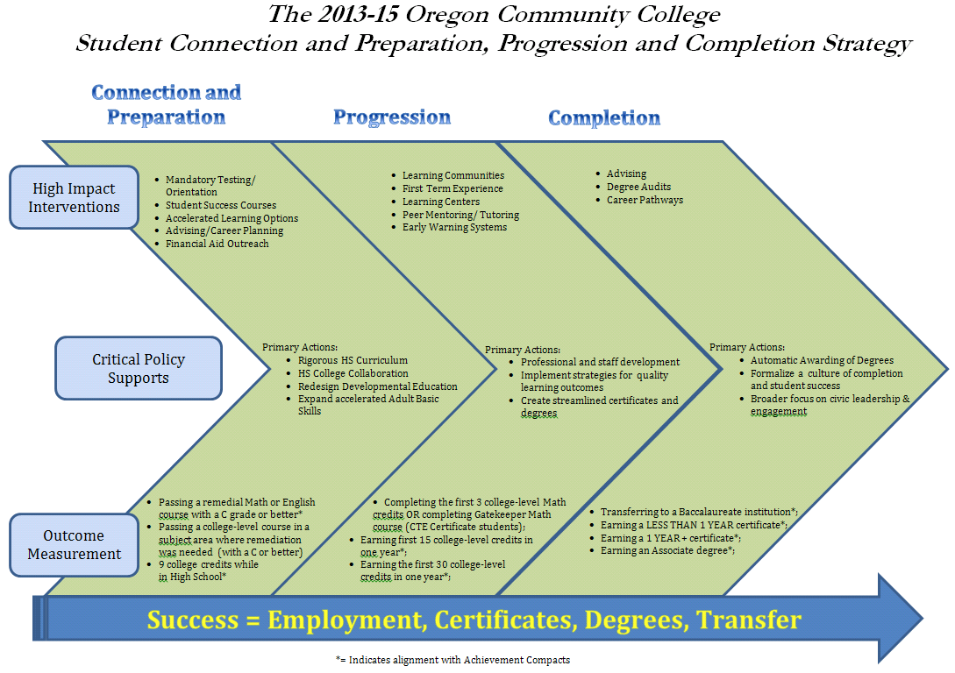



Slide 15
Oregon College Initiatives
  Achieving the Dream (10 Oregon colleges)
  Complete College America
  Developmental Education Redesign
  Foundations of Excellence
  Statistics/Quantitative Literacy Math Pathways
  CCSSE/SENSE
  National Career Readiness Certificate
  Degree Qualifications Profile (Lumina)
  Reverse Transfer
  CASE/TAACT grants
  Win-Win
  Data for Analysis (D4A)
Notes:
15

Slide 16
Oregon College Initiatives
  Under consideration by the Oregon legislature
  Pay it Forward
  Credit for Prior Learning
  Oregon Promise (2 years of CC free)
  Outcomes-based funding
  Non-credit certificates for workforce training
  Associate of Science in Computer Science Degree
Notes:
16

Slide 17
Notes:
17

Slide 18
Here’s the good news…
  It’s all the same work!!
Student learning, persistence, completion
Creating a culture of evidence
Identifying and implementing high-impact practices
Tying funding to improved outcomes
A focus on different segments of students’ academic pathways
Notes:
18

Slide 19
  Do you know how engaged students are in those practices that matter most?
  You say…
  Students say…
Notes:
19

Slide 20
  What % of Oregon Community College students responding to the SENSE survey said they felt welcome the first time they came to the college?
  You say…
  Students say…
22
Notes:
Narrative:
Map:
Item Key:

Slide 21
  What % of Oregon Community College students responding to the SENSE survey said they felt welcome the first time they came to the college?
  You say…
  Students say… 73%
22
SENSE 2012
Notes:
Narrative:
Map:
Item Key:

Slide 22
  What % of Oregon Community College students responding to the CCSSE survey said they worked with other students on projects during class (often or very often)
  You say…
  Students say…
Notes:
Narrative:
Map:
Item Key:

Slide 23
  What % of Oregon Community College students responding to the CCSSE survey said they worked with other students on projects during class (often or very often)
  You say…
  Students say… 54%
CCSSE 2014
Notes:
Narrative:
Map:
Item Key:

Slide 24
  What % of Oregon Community College students responding to the CCSSE survey said they received prompt feedback (written or oral) from instructors on their performance in class (often or very often)?
  You say…
  Students say…
Notes:
Narrative:
Map:
Item Key:

Slide 25
  What % of Oregon Community College students responding to the CCSSE survey said they received prompt feedback (written or oral) from instructors on their performance class (often or very often)?
  You say…
  Students say…62%
Notes:
Narrative:
Map:
Item Key:

Slide 26
  What % of Oregon Community College students responding to the CCSSE survey said they worked harder than they thought they could to meet an instructor’s expectations?
  You say…
  Students say…
Notes:
Narrative:
Map:
Item Key:

Slide 27
  What % of Oregon Community College students responding to the CCSSE survey said they worked harder than they thought they could to meet an instructor’s expectations?
  You say…
  Students say… 53%
Notes:
Narrative:
Map:
Item Key:

Slide 28
  What do Oregon students say is the most important college service?
  (CCSSE 2014)
Academic Advising & Planning
91%
Notes:
28

Slide 29
Yet…
39%
…of students say they rarely or never saw an advisor.
(or really aren’t sure…)

Slide 30
  Oregon students’ most important services -
  Very or Somewhat Important % Using Services Sometimes/Often
  Academic Advising 91% 61%
  Computer Lab 82% 56%
  Financial Aid 81% 48%
  Career Counseling 79% 27%
  Skill Labs 77% 41%
  Tutoring 76% 33%

Slide 31
Students don’t do optional!!

Slide 32
Student Engagement and Student Success

Slide 33
What is Student Engagement?
…the amount of time and energy students invest in meaningful educational practices
…the institutional practices and student behaviors that are highly correlated with student learning and retention

Slide 34
The Center for Community College Student Engagement
CCCSE Data – Quantitative – the “what”
CCSSE
CCFSSE
SENSE
CCIS
Focus groups – Qualitative – the “why”
Initiative on Student Success
High-Impact Practices Initiative
Improving Outcomes for Men of Color
Strengthening the Role of Part-Time Faculty
Latino Student Engagement and Transfer
Notes:
The Center for Community College Student Engagement administers four surveys that complement one another: CCSSE, CCFSSE, and SENSE. All are tools that assess student engagement — how connected students are with college faculty and staff, with other students, and with their studies. Together, the four surveys provide a comprehensive view of educational practice on community college campuses.
The Survey of Entering Student Engagement (SENSE) focuses on students’ experiences from the time of their decision to attend their college through the end of the first three weeks of the fall term.
The Community College Survey of Student Engagement (CCSSE) surveys credit students and gathers information about their overall college experience. It focuses on educational practices associated with higher levels of learning, persistence, and completion.
The Community College Faculty Survey of Student Engagement (CCFSSE) is administered in conjunction with CCSSE. The faculty survey reports on instructors’ perceptions of student experiences as well as data about faculty members’ teaching practice and use of professional time.
The Community College Institutional Survey (CCIS) collects information about whether and how colleges implement a variety of promising practices.
The Center works with participating colleges to administer the surveys, and then the colleges receive their survey results, along with guidance and analyses they can use to improve their programs and services for students.

Slide 35
One thing we KNOW about community college student engagement…
It’s unlikely to happen by accident.
It has to happen
by design.

Slide 36
Building a Culture of Inquiry and Evidence
Have you ever seen CCSSE or SENSE results?
Have you ever logged into the online reporting system?
Have you formed a workgroup, discussed CCSSE or SENSE and other data, and used that data to inform decisions to change something at your college or on your campus?

Slide 37
Oregon Colleges’ Survey Administration
  From 2 to 8 TIMES!
  It’s time to use your data to build a culture of inquiry and evidence!
Notes:
37

Slide 38
Benchmarks and Benchmarking

Slide 39
Benchmarking for Excellence
The most important comparison: where you are now, compared with where you want to be.
Other comparisons and ways to identify effective practices:
Within your own college
Across your consortium
Looking at other colleges most like you

Slide 40
Center Benchmarks of Effective Educational Practice
Groups of conceptually-related items
Standardized to a national mean of 50
Address key areas of student engagement
Provide a way for colleges to compare their own performance with other groups of colleges and across student groups

Slide 41
CCSSE Benchmarks for Effective Educational Practice
  Active and Collaborative Learning
  Student Effort
  Academic Challenge
  Student-Faculty Interaction
  Support for Learners
Notes:
CCSSE reports survey results in two ways: students’ responses to individual survey items, which are presented in absolute terms, and national benchmarks.
Benchmarks are groups of conceptually related items that address key areas of student engagement. CCSSE’s five benchmarks denote areas that educational research has shown to be important in quality educational practice.
The five benchmarks of effective educational practice are active and collaborative learning, student effort, academic challenge, student-faculty interaction, and support for learners.

Slide 42
SENSE Benchmarks
Early Connections
High Expectations and Aspirations
Clear Academic Plan and Pathway
Effective Track to College Readiness
Engaged Learning
Academic and Social Support Network

Slide 43
Oregon Colleges’ CCSSE Benchmarks
Oregon 2014 Cohort
Active & Collaborative Learning 51.0 50.0
Student Effort 50.2 50.0
Academic Challenge 50.6 50.0
Student-Faculty Interaction 50.6 50.0
Support for Learners 47.5 50.0

Slide 44
Oregon Colleges’ Benchmark Range
15 colleges
  High Low Consortium
  Active and Collaborative Learning 56.3 46.1 51.0
  Student Effort 55.9 46.4 50.2
  Academic Challenge 55.4 46.0 50.6
  Student-Faculty Interaction 58.0 45.0 50.6 Support for Learners 54.3 42.9 47.5
Source: 2014 CCSSE data

Slide 45
Oregon Small Colleges’ Benchmark Range
9 small colleges
  High Low
  Active and Collaborative Learning 56.3 46.1
  Student Effort 55.4 46.5
  Academic Challenge 55.4 46.0
  Student-Faculty Interaction 58.0 47.2 Support for Learners 54.3 43.4
Source: 2014 CCSSE data

Slide 46
One Oregon College’s
CCSSE Benchmarks
Your College Small Colleges
Active & Collaborative Learning 56.3 51.4
Student Effort 54.6 51
Academic Challenge 55.4 50.4
Student-Faculty Interaction 58 52.4
Support for Learners 54.3 52.1

Slide 47
One Oregon College’s
CCSSE Benchmarks
Your College Small Colleges
Active & Collaborative Learning 46.1 51.4
Student Effort 46.5 51
Academic Challenge 46 50.4
Student-Faculty Interaction 50.8 52.4
Support for Learners 48.6 52.1

Slide 48
Disaggregating Benchmark Data
  Oregon Consortium:
  By Enrollment Status
  FT PT
  Active and Collaborative Learning 55.9 47.1
  Student Effort 54.2 47.4
  Academic Challenge 55.9 46.5
  Student-Faculty Interaction 55.6 46.8 Support for Learners 50.0 46.0
Source: 2014 CCSSE data

Slide 49
Disaggregating Benchmark Data
  Oregon Consortium:
  Developmental Status
  Dev Non-Dev
  Active and Collaborative Learning 52.3 49.6
  Student Effort 54.6 45.2
  Academic Challenge 53.6 47.9
  Student-Faculty Interaction 53.3 47.8 Support for Learners 51.9 43.4
Source: 2014 CCSSE data

Slide 50
Disaggregating Benchmark Data
  Oregon Consortium:
  By Credit Hours Earned
  30+ 0-29
  Active and Collaborative Learning 56.2 45.9 Student Effort 53.0 47.4
  Academic Challenge 54.6 47.0
  Student-Faculty Interaction 54.7 46.6 Support for Learners 48.0 47.0
Source: 2014 CCSSE data

Slide 51
Looking at Your CCSSE Data Across Time

Slide 52
What sort of data are we talking about?
Benchmarks – scores on high level concepts to get you into the results
Means – place responses on a scale to allow comparison
Frequencies – give you details about the actual responses/behaviors

Slide 53
The Data – Where To Begin
At least three administrations since 2005
Benchmarks
  CCSSE website: Standardized benchmark scores are not appropriate for longitudinal analysis.
  Standardized scores re-standardized every year based on 3-year cohort
  Raw benchmark scores – available in download data file.
    Scale: 0 - 1
Notes:
3 time points – While only 2 time points necessary to establish a line, at least 3 are necessary for a trend – and even more for a reliable assessment of the presence and persistence of a trend. Survey data prior to 2005 is not comparable because a number of the items in the surveys were modified, removed, or new ones added during the item development and pilot phases.
As noted earlier, however, keep in mind that patience is important as early disappointing results are common.
Many CCSSE users are very familiar with our benchmark scores and, because the standardized scores are the ones we present in our on-line reporting system, their first thought is to use these.
However, CCSSE website states standardized benchmark scores are not appropriate. Why not?
Every year standardized benchmarks are recalculated based on that year’s 3-year cohort.
A benchmark score of 51 in one year is not necessarily the same as a 51 in any other year. These scores were designed to present a relative snapshot in time.
If you participated in 2012 and not in 2013 and log into the member’s only site and run an analysis of your benchmark scores in the 2012 archive section and again in the 2013 section, you may notice that your benchmark scores are slightly different – this is because the 2013 cohort consists of approximately 1/3rd new respondents.
So what should I use? Your download data set available from the standard reports page includes the standardized scores, but also what we call raw benchmark scores. Since the raw benchmark scores are not standardized, they are unaffected by the changing characteristics of the cohort population from year to year.
Since the benchmarks are a central component of CCSSE, let’s take a moment to review how they are created.

Slide 54
Standardized vs. Raw Benchmark Scores
 | Standardized
Benchmark | 2008 | 2014 | % Change
Active and Collaborative Learning | 52.08 | 51.08 | -1.92
Student Effort | 51.58 | 50.35 | -2.40
Academic Challenge | 51.39 | 50.95 | -0.86
Student-Faculty Interaction | 52.83 | 50.49 | -4.42
Support for Learners | 49.48 | 47.51 | -3.98
Raw
2008 | 2014 | % Change
0.372 | 0.382 | 2.73
0.465 | 0.472 | 1.44
0.567 | 0.587 | 3.61
0.402 | 0.429 | 6.61
0.412 | 0.430 | 4.58
Source: 2014 CCSSE data
Notes:
So how much difference can the use of standardized scores have compared to the raw benchmark scores you ask? Quite a bit, actually.
Using real data, let’s take a look at what can happen. These data are from a college that administered CCSSE 3 years apart. You will notice that the change for all benchmarks except support for learners is negative, implying that this college’s engagement declined between the two administration time points. The Student-Faculty Interaction benchmark showed the greatest decline.
Now, look at the raw benchmark scores for these two years. In all cases, the score change was positive – even for Student-Faculty Interaction.

Slide 55
Oregon State-Wide Raw Benchmark Scores
2008, 2011, and 2014
Source: 2014 CCSSE data
Notes:
This slide shows the trend in annual raw benchmark scores for all CCSSE benchmarks from 2009 to 2013.
As you can see from this graph, the general trend for the Example College’s benchmark scores have been slightly positive.
Looking closely at the trends in this graph, we see that ACTCOLL and SUPPORT show a slow decline since 2011. Is this normal fluctuation, or is it an emerging trend?
This trend is clearer in the next slide that shows the percent change in the raw benchmark scores from year to year.

Slide 56
What’s Driving Benchmark Scores:
Student-Faculty Interaction Benchmark Items – Means
 |  | 2008 | 2011 | 2014 | % Diff
4k | Used email to communicate with an instructor | 2.63 | 2.83 | 2.95 | 12.100
4l | Discussed grades or assignments with an instructor | 2.57 | 2.61 | 2.63 | 2.082
4m | Talked about career plans with an instructor or advisor | 2.12 | 2.13 | 2.18 | 2.864
4n | Discussed ideas from your readings or classes with instructors outside of class | 1.78 | 1.80 | 1.79 | 0.571
4o | Received prompt feedback (written or oral) from instructors on your performance | 2.75 | 2.76 | 2.76 | 0.279
4q | Worked with instructors on activities other than coursework | 1.38 | 1.38 | 1.41 | 1.611
Source: 2014 CCSSE data
Notes:
Let’s start by looking at the means.
Here we see changes from 2009 to 2013 (end-points only). Earlier we saw that the Active & Collaborative raw benchmark score showed a slight increase from 2009 to 2013.
This table is an excellent example of what I said earlier about one of the limitations of the benchmarks: As aggregate measures, benchmarks can mask real changes at the item level.
As this table shows, items 4f (Worked with other students on projects during class) and 4h (Tutored or taught other students) cancel each other out as do items 4g (Worked with classmates outside of class to prepare class assignments) and 4f (Discussed ideas from your readings or classes with others outside of class).
Again, looking at the end-points we see considerable change in the average item scores from 2009 to 2013. But what was happening between these years?

Slide 57
What’s Driving Benchmark Scores:
Student-Faculty Interaction Benchmark Items - Means
Source: 2014 CCSSE data
Notes:
This slide shows the trends in the item-level means from 2009 – 2013 for the items in the Active and Collaborative benchmark.
This shows there is fluctuation annually between increases and decreases in average scores for this college and that the highest average score on these items was not always at the endpoints, in fact, for 4 of the 7 items the means declined from the 2011 administration though the 2013 administration.
The means tell us what the trajectory of the responses are over the years. However, what they do not show us is where those changes are happening. In other words, are we looking at a minor shift of students from adjacent categories (do we have a shift in the number of people responding sometimes to never or vise-versa, or do we have a major shift with the percent of respondents reporting very often shifting to sometimes or never, or vise-versa)? The only way to determine this is to look at the percentage of students responding to each level of the items.

Slide 58
What’s Driving Benchmark Scores:
Student-Faculty Interaction Benchmark Items - Frequencies
 |  | 2008 | 2011 | 2014 | % Diff
4k | Used email to communicate with an instructor | 13.73 | 8.20 | 5.91 | -56.956
4l | Discussed grades or assignments with an instructor | 7.97 | 6.94 | 8.46 | 6.148
4m | Talked about career plans with an instructor or advisor | 24.18 | 24.73 | 23.39 | -3.267
4n | Discussed ideas from your readings or classes with instructors outside of class | 42.69 | 41.57 | 43.13 | 1.031
4o | Received prompt feedback (written or oral) from instructors on your performance | 5.52 | 5.12 | 6.26 | 13.406
4q | Worked with instructors on activities other than coursework | 70.73 | 70.97 | 70.29 | -0.622
Percentage reported NEVER doing
Source: 2014 CCSSE data
Notes:
Showing frequencies for each response option would require a lot of space and not very feasible for a power point presentation. So, is there a better way to present frequency data in a more concise and informative way?
One way would be to dichotomize the items into desired vs. less-desired behaviors. For example, the items for the Active and Collaborative benchmark all have the same response scale (Never, Sometimes, Often, and Very often). Since NEVER is the one absolute value in this scale, I have dichotomized the responses to Never vs. Ever done the activity. This table shows the percent of respondents each year who reported NEVER doing these seven activities in 2009 and 2013.
Let’s take a closer look at these items – Are the trends shown here looking at the end points a reflection of a slow but steady change, or are there fluctuations that we’re not seeing?
If you remember from a couple of slides ago, item 4f, worked with other students on projects showed a 5 percent increase from 2009 to 2013 in mean scores. That could very well be the result, at least in part, of the 17.5% drop in the number of students reporting that they never engage in this activity.
The means for item 4h, tutored or taught other students, showed a 5.8% decline in the average item score over the 5-year period. We see here that there was a 6.1% increase in the number of students who reported they never did this. Again, at least a partial explanation of the change we saw in the means. Items 4a and 4r also showed larger declines in means over time, which, makes sense given the considerable increase in the number of students reporting they never engage in those activities.
In looking at these results closely, it is possible that the changes we see in the percent of students reporting they never engage in these activities explains the mean changes, but it is likely that the full understanding lies in seeing the change at each of the levels – this is the only way to fully understand the changes in the means and whether those changes reflect a minor change in behaviors, or a major shift. I don’t show these changes here.

Slide 59
What’s Driving Benchmark Scores:
Percentage Never Doing Activities on the
Student-Faculty Interaction Benchmark
Source: 2014 CCSSE data
Notes:
Since Never is an undesirable response for these 7 items, we would hope to see consistently declining trend lines here. Unfortunately, that is not what we are seeing.

Slide 60
Item Differences by Subgroup
Selected Student-Faculty Interaction Items
Source: 2014 CCSSE data
Notes:
Percent change from 2006 to 2014:
4k. EMAIL FT Full-time Used email to communicate with an instructor 19.54 pts 36.798%
4k. EMAIL PT Part-time Used email to communicate with an instructor 27.77 pts 77.700%
4m. FACPLANS FT Full-time Talked about career plans with an instructor or advisor 6.44 pts 23.116%
4m. FACPLANS PT Part-time Talked about career plans with an instructor or advisor 6.56 pts 34.131%

Slide 61
Q & A

Slide 62
A quick look at the CCSSE online reporting system.
Standard Reports
Custom Reports
Online tutorials for Online Reporting System:
  http://www.ccsse.org/tools/tutorials.cfm

Slide 63
Digging into your data
Review the benchmark data. Where are your strengths? Which areas will you target for improvement?
Pick one benchmark for this discussion.
Review the frequency responses within that benchmark.

Slide 64
Discussion Questions
What questions do the data raise for you?
What, if anything, about the data surprises you?
What additional information do you need about these data?
What is one thing you, or the college, could do to address these data?

Slide 65
LUNCH

Slide 66
High-Impact Practices for Student Success

Slide 67
CCCSE Special Study on Promising Practices
What is it?
Online Institutional Survey (CCIS)
Special-focus items on CCSSE
Items added to CCFSSE
Special-focus module on SENSE
Lots of data

Slide 68
High-Impact Practices for Community College Student Success
  Assessment and Placement
  Orientation
  Academic Goal Setting and Planning
  Registration before Classes Begin
  Accelerated or Fast-Track Developmental Education
  First-Year Experience
  Student Success Course
  Learning Community
  Class Attendance
  Alert and Intervention
  Experiential Learning beyond the Classroom
  Tutoring
  Supplemental Instruction

Slide 69
Late Registration
During the current term at this college, I completed registration before the first class session(s). (CCSSE Promising Practices, Item #1)
Source: 2014 CCSSE data
Percentages may not total 100% due to rounding
Notes:
Maine DATA- Maybe not appropriate because we don’t have CCFSSE data

Slide 70
Orientation
The ONE response that best describes my experience with orientation when I first came to this college is... (CCSSE Promising Practices, Item #2)
Source: 2014 CCSSE data
Percentages may not total 100% due to rounding
Notes:
Maine DATA RIGHT NOW

Slide 71
First-Year Experience
During my first term at this college, I participated in a structured experience for new students... (CCSSE Promising Practices, Item #3)
Source: 2014 CCSSE data
Percentages may not total 100% due to rounding
Notes:
Maine DATA RIGHT NOW

Slide 72
Learning Community
During my first semester at this college, I enrolled in an organized learning community... (CCSSE Promising Practices, Item #4)
Source: 2014 CCSSE data
Percentages may not total 100% due to rounding
Notes:
Maine DATA RIGHT NOW

Slide 73
Student Success Course
During my first semester/quarter at this college, I enrolled in a student success course (such as a student development, extended orientation, study skills, student life skills, or college success course). (CCSSE Promising Practices, Item #5)
Source: 2014 CCSSE data
Percentages may not total 100% due to rounding
Notes:
Maine DATA RIGHT NOW

Slide 74
Do these practices make a difference?
Series of Center Reports on High-Impact Practices

Slide 75
2014 Oregon CCSSE Benchmark Scores by Orientation
Source: 2014 CCSSE data

Slide 76
2014 Oregon CCSSE Benchmark Scores by First-Year Experience
Source: 2014 CCSSE data

Slide 77
2014 Oregon CCSSE Benchmark Scores by Learning Community
Source: 2014 CCSSE data

Slide 78
2014 Oregon CCSSE Benchmark Scores by Student Success Course
Source: 2014 CCSSE data

Slide 79
2014 CCSSE Benchmark Scores
by Accelerated Developmental Education
Participated in Accelerated Developmental Course
Did Not Participate in Accelerated Developmental Course
Sources: 2014 CCSSE data
Notes:
In = 25614 Out = 94545

Slide 80
Relatively small numbers of students are experiencing high impact practices, but for those who do, we consistently see higher levels of engagement.

Slide 81
So now what?
Let’s look a bit deeper. Are we implementing high-impact practices for students who need them the most?

Slide 82
Subgroup Analysis
30% of Oregon Developmental Students reported experiencing a student success course during their first term.
17% of Oregon Non-Developmental students reported experiencing a student success course during their first term.
Source: 2014 CCSSE data

Slide 83
2014 Oregon CCSSE Benchmark Scores For Student Success Course Participation – By Dev Status
Source: 2014 CCSSE data

Slide 84
Does a student success course differentially affect developmental education students vs. non-developmental education students?
Notes:
Although we think these high impact practices are good for everyone, if your college cannot afford to scale an intervention for the entire college, you could run an analysis like this and see that student success courses are especially important to developmental education students.
→ After asking the question, flip back to the previous slide for discussion.

Slide 85
What other points of data do you need to explore to make this more informative?
Success rates between the student types
Success rates between the student types based on having the course or not
Other demographic information for the student groups
Whether students in the student success course groups were receiving other services
Etc…..

Slide 86

Design Principles for Effective Practice
A strong start
Clear, coherent pathways
High expectations and high support
Integrated support
Intensive student engagement
Learning in context
Accelerated learning
Design for scale
Professional Development

Slide 87
Sharing Promising Practices

Slide 88
Chemeketa Community College
What We Discovered in the Data
The majority of entering students arrive at the college intending to succeed and believe they have the motivation to do so
Engage early and engage often
Academic Advising

Slide 89
Chemeketa Community College
What We Did As A Result of What We Saw in Our Data
A deeper dive at the data … by disaggregating the data we were able to look at results by age, ethnicity, gender, and enrollment status to identify any gaps
Presented results in functional meetings that include faculty, exempt, and classified employees
Results posted online

Slide 90
Chemeketa Community College
How We Measure Our Progress
As a result of several initiatives, we are seeing steady improvement in:
  Term-to-term persistence
  Fall-to-fall retention
  Average number of credits attempted
  Successful completion in college-prep courses
Focusing on students’ experience at Chemeketa

Slide 91
Linn-Benton Community College
What We Discovered in the Data
Overall institutional results have been consistent
  Declining benchmark scores seem more due to relative national improvement
Lower reported engagement with part-time, men, and traditionally aged students
Higher reported engagement with developmental students

Slide 92
Linn-Benton Community College
What We Did As A Result of What We Saw in Our Data
Began college-wide promotional efforts
  Presented results to various campus groups, utilized findings in other data awareness campaigns, and facilitated workshops for faculty and staff
Working with leadership to connect engagement strategies to ongoing college initiatives

Slide 93
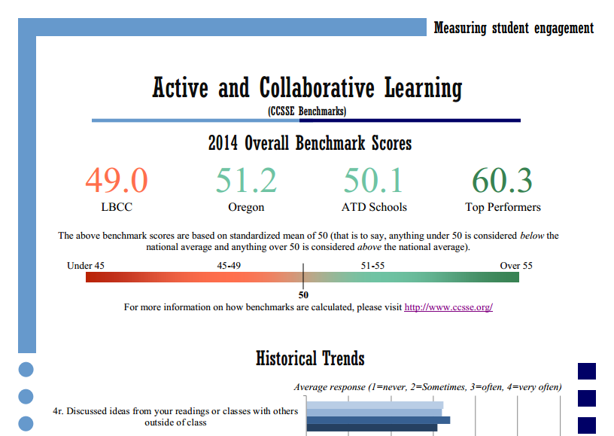
Linn-Benton Community College
How We Measure Our Progress
Track and disseminate longitudinal results using user-friendly fact sheets
Plan to incorporate engagement evaluation as part of broader assessment strategies

Slide 94
Action Planning & Next Steps

Slide 95
Short-Term Action Plan Template

Slide 96
What Matters Most for Student Success?

Slide 97
Students persist when they:
  Are active & engaged learners
  Establish meaningful relationships with faculty, staff and peers
  Have high expectations & aspirations
  Navigate successfully through the front door -- college systems, processes and procedures
  Have more structure, fewer options, clearer pathways
Notes:
97
97

Slide 98
Make it Mandatory
How do students feel about “MANDATORY” ?
a. Frightened
b. Appreciative
c. Disgruntled
d. Rebellious
e. Depressed
Students want our guidance…
Even though they
complain
about it.
Key Question: Does “mandatory” really mean mandatory?

Slide 99
High Performing Colleges
…make student engagement inescapable!

Slide 100
Tools to Help You www.cccse.org
Examples from Member Colleges
Student Focus Group Toolkit
Focus Group Tools for High-Impact Practices, Men of Color and Faculty & Staff
Discussion Guides
Video clips
Classroom Observation Form
Course Evaluation Form

Slide 101
Q and A
Thanks for joining us!

